Slide 1
Design Patterns & Object Diagrams
Game 253

Slide 2
Introduction
Iterator
Handle
Model Database
Appearance Map
Magnetism
Shield
Visual State
Automatic Mode Cancellation
Focus
Progress
Object Diagrams

Slide 3
Iterator
Access members of a container without knowing the structure of the container

Slide 4
Iterator
Returns every member of the container once
Has knowledge of the end of the container
Visits members in a pre-defined order*
Provides methodology for moving from one member to the next

Slide 5
Standard Template Library
Container::iterator is a type used to declare an iterator
Container::begin() returns an iterator to the first member
Container:end() returns a past-the-end iterator
STL Iterators
  - operator++() moves to the next member
  - operator*() retrieves the member value
  - operator==() compares iterators
  - operator!=() compares iterators

Slide 6
Y Iterate Tho?
Separates access logic from container implementation
If the container implementation is changed no logic accessing the container needs to change
Iterating is very often a necessity in game programming, best to do it right

Slide 7
C++

Slide 8
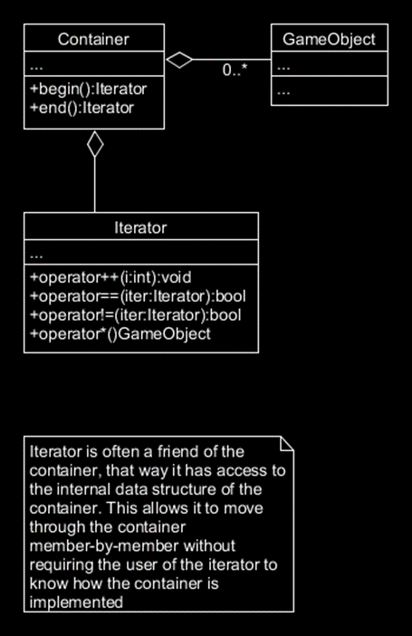
Iterator
A simple implementation of the iterator pattern for a container of game objects.

Slide 9
Handle
Provides access to an object without revealing the identity of the object

Slide 10
Handle
A handle is similar to a pointer, in that they both are used to access an object
A pointer contains the address of the item it points at
A handle is an abstraction of a reference
A handle at its most simple may be an integer that is the index in a table that the item the handle points at exists in (ID)

Slide 11
Asset Database
Centralised storage for all assets in game

Slide 12
Asset Database
Instead of each object loading assets and storing them in memory individually, asset loading is centralised
Assets may be reference by pointer / name / handle
Can support further design pattern modifications (lazy loading)
Ensures that only unique assets exist in memory
If 100 things use the same asset, the asset is loaded once, then each of the 100 things uses a reference to the same one asset

Slide 13
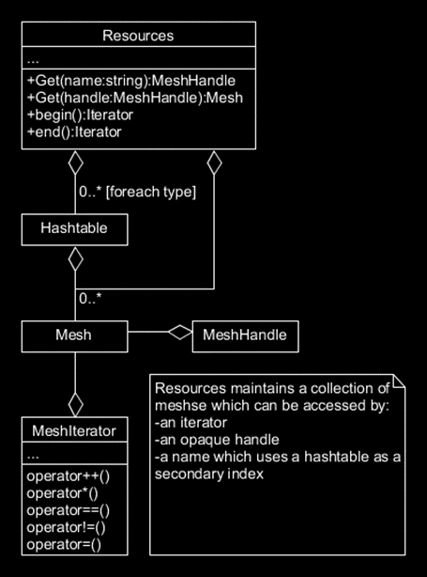
Asset Database
A simple implementation of an asset database that can store meshes

Slide 14
Appearance Map
Isolates an objects state from the visual appearance of the object

Slide 15
Appearance Map
Objects in game can change their appearance, usually due to their state
Placing all the object appearance logic inside their controller can make the logic overly complex
Instead make a representation that maps the object states and times to appearances (Unity – Mecanim State Machine)

Slide 16
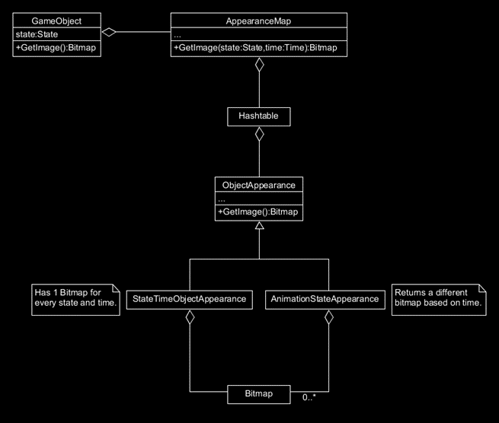
Appearance Map
A simple implementation of an appearance map

Slide 17
Mini Kernal
Control logic localisation

Slide 18
Mini Kernal
Move the control logic for each object into a system
Allow systems to register with the central controller (The Engine)
Propagate updates from the central controller to each system
Central controller is simple now
Objects can be added and removed from the systems, only updating those that need to be
Adding new object types does not require a change of the central controller

Slide 19
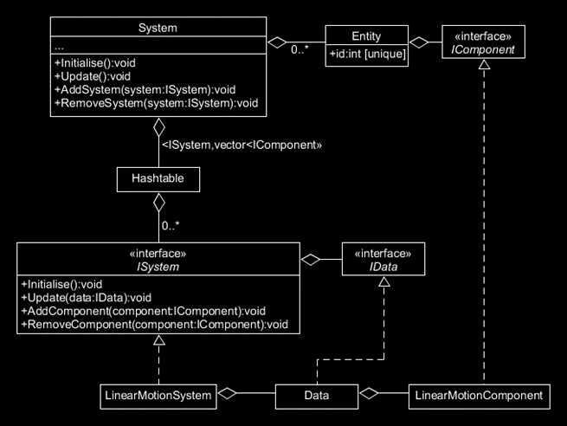
Mini Kernal
A simple implementation of a mini kernal

Slide 20
Usability Patterns
A set of patterns that try to make content more user friendly

Slide 21
Magnetism
Hit detection made easier to use

Slide 22
Magnetism
Small objects can be hard to click on, so instead of performing accurate hit detection, we use simpler hit detection
This decreases the complexity of click detection on small objects (more frames, yay)

Slide 23


Magnetism
A: check the mouse position, read the pixel at that position and check its transparency
B: check if the mouse position is inside the box before reading the pixel and checking transparency
C: check if the mouse position’s distance from the icon is less than the radius of our bounding circle

Slide 24
Magnetism
Instead of checking if they click on the actual icon, let them click within a radius of the icon

Slide 25
Shield
Controls that would cause undesirable consequences are protected from accidental use

Slide 26
Shield
Shielding takes many forms:
Disabling controls that are not needed during the current game context
Requiring confirmation before performing the action
Could require double clicking, or other modifications to the input

Slide 27
Visual State
Representing data visually so the player can more easily keep track of it

Slide 28
Visual State
Consider:
  - Entities may have status effects, the visual state of which may be particle effects, or other VFX, to represent the status effect (On Fire looks like they are on fire)
  - The screen may have VFX applied to it based on entity state
  - Pulsing, bloody screen edges on low health
  - Heads Up Display

Slide 29
Automatic Mode Cancellation
Automatically switch between contexts depending on input

Slide 30
Automatic Mode Cancellation
Consider:
  - The player is currently searching a container, which uses mouse input to navigate (it is an in game menu)
  - If the player uses movement input, automatically close the menu, and return to standard gameplay

Slide 31
Focus
Reduce the amount of information on screen to only what is necessary

Slide 32
Focus
Greying out buttons
Hiding state based HUD when the state information isn’t important.
Only show health when health is less than 100%
Zooming in on a specific area of the game world to ignore the res

Slide 33
Progress
Visually depicts the progress of an operation

Slide 34
Progress
If we don’t show the player something when we are loading, they may think the application is frozen
This can be used elsewhere too:
  XP to next level
  Quest Progression
  Recipe Completion
  Et Cetera

Slide 35
Object Diagram
A pause frame of game state represented in a class diagram

Slide 36
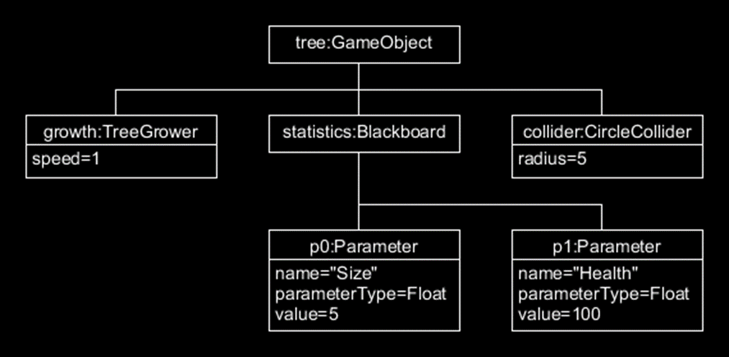
Object Diagram
See how it is very similar to a class diagram, but representing only the classes, and values that this ‘tree’ GameObject has.

Slide 37
Have a good week!
Stay safe out there!

